Slide 1
Multithreading and concurrency

Slide 2
Multithreading and concurrency
Introduction
Multithreading
Thread and runnable.
Thread Life Cycle
Synchronization mechanism.
Guarded Blocks.
Synchronized block.
Executors services.
Synchronization problems

Slide 3
Introduction
What is multithreading?
Why we need they?
How use they?

Slide 4
Multithreading
What is multithread?
Multithreading is when you can subdivide specific operations within a single application into individual threads. Each of the threads can run in parallel. The OS divides processing time not only among different applications, but also among each thread within an application.
Why we need they?
Multithreading enables you to write in a way where multiple activities can proceed concurrently in the same program.
Process 1
Thread 1
Thread 2
Thread 3
Thread 4
Thread 5
CPU
Core 1
Core 2
Core 3
Core 4
Notes:
Show Gif image:
http://www.j2eeonline.com/java2-programmers-certification/module7/images/multithreading.gif

Slide 5
Thread and Runnable.
Introduction
Thread of execution is the smallest sequence of programmed instructions that can be managed independently by a scheduler (typically as part of an operating system). The implementation of threads and processes differs from one operating system to another, but in most cases, a thread is a component of a process.
Defining and Starting a Thread
Method 1: Extends Thread class and implement run() method.
Ex:
public class SimpleThread extends Thread {
public void run() {………….}
}
(new SimpleThread ()).start()
Method 2: Implement interface Runnable
Ex:
public SimpleTask implements Runnable {
public void run() {…….....}
}
(new Thread(new SimpleTask ())).start()

Slide 6
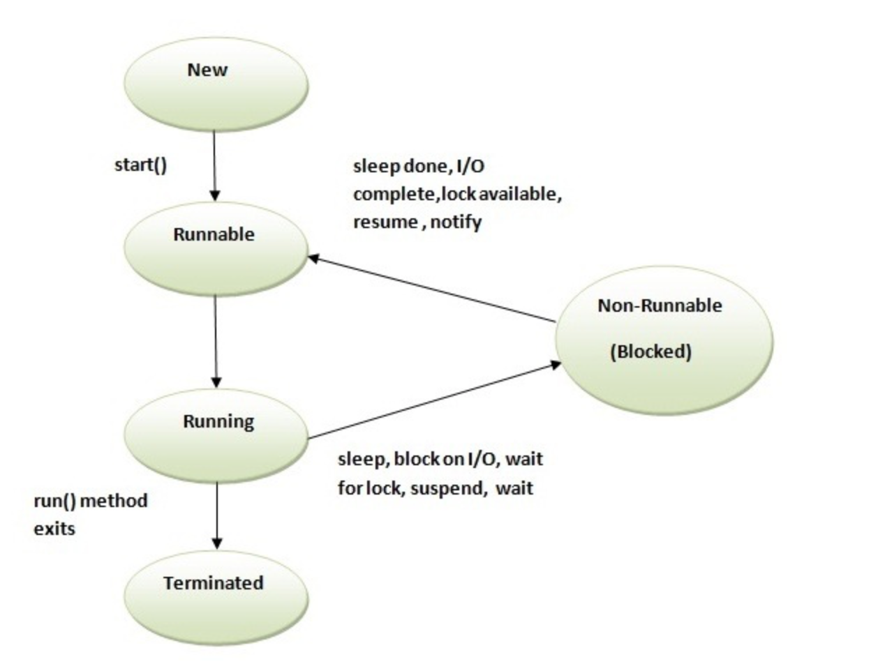
Thread Life Cycle
Notes:
When you call notify only one of waiting thread will be woken and its not guaranteed which thread will be woken, it depends upon Thread scheduler.
While if you call notifyAll method, all threads waiting on that lock will be woken up, but again all woken thread will fight for lock before executing remaining code and that's why wait is called on loop because if multiple threads are woken up, the thread which will get lock will first execute and it may reset waiting condition, which will force subsequent threads to wait.
wait() tells the calling thread to give up the monitor and go to wait until some other thread enters the same monitor and calls notify( ) or notifyAll().
Thread.sleep causes the current thread to suspend execution for a specified period.
Thread.yield
Notify the system that the current thread is willing to "give up the CPU" for a while.
The thread scheduler will select a different thread to run instead of the current one.
join method is used to pause the current thread execution until unless the specified thread is dead.
If t is a Thread object whose thread is currently executing,
t.join();
causes the current thread to pause execution until t's thread terminates.

Slide 7
Running Life Cycle
Runnable
notify()
notifyAll()
join()
sleep()
wait()
yield()
interrupt()
System.exit()
Dead
Running
Notes:
When you call notify only one of waiting thread will be woken and its not guaranteed which thread will be woken, it depends upon Thread scheduler.
While if you call notifyAll method, all threads waiting on that lock will be woken up, but again all woken thread will fight for lock before executing remaining code and that's why wait is called on loop because if multiple threads are woken up, the thread which will get lock will first execute and it may reset waiting condition, which will force subsequent threads to wait.
wait() tells the calling thread to give up the monitor and go to sleep until some other thread enters the same monitor and calls notify( ) or notifyAll().
Thread.sleep causes the current thread to suspend execution for a specified period.
Thread.yield
Notify the system that the current thread is willing to "give up the CPU" for a while.
The thread scheduler will select a different thread to run instead of the current one.
join method is used to pause the current thread execution until unless the specified thread is dead.
If t is a Thread object whose thread is currently executing,
t.join();
causes the current thread to pause execution until t's thread terminates.

Slide 8
Synchronization mechanism
Problem:
What happen then in same time two or more thread will execute the same code?
Thread Interference - describes how errors are introduced when multiple threads access shared data.
Memory Consistency Errors - describes errors that result from inconsistent views of shared memory.
Solution:
We need to synchronize code. Existing mechanism to make synchronization in Java:
Semaphores - is a variable or abstract data type that is used for controlling access, by multiple processes, to a common resource in a parallel programming or a multi user environment.
Lock - is a synchronization mechanism for enforcing limits on access to a resource in an environment where there are many threads of execution.
Synchronized methods and blocks - Use reserved ‘synchronized’ keyword to make thread safe and synchronized code.
Monitors (wait/notify and sleep) - is a synchronization construct that allows threads to have both mutual exclusion and the ability to wait (block) for a certain condition to become true. A monitor consists of a mutex (lock) object and condition variables.
Use specialized API
Thread pooling mechanism - is an implementation of the ExecutorService interface, what consist of worker threads(a pool) that execute sequentially a set of tasks(runnable, callable). This kind of thread exists separately from the Runnable and Callable tasks it executes and is often used to execute multiple tasks.
Fork Join mechanism - is an implementation of the ExecutorService interface that helps you take advantage of multiple processors. It is designed for work that can be broken into smaller pieces recursively.
Atomic classes - The java.util.concurrent.atomic package defines classes that support atomic operations on single variables. Uses synchronized method and blocks to implement atomicity.
Lock objects - support locking idioms that simplify many concurrent applications.

Slide 9
Synchronized block
Introduction:
Synchronization is built around an internal entity known as the intrinsic lock or monitor lock. (The API specification often refers to this entity simply as a "monitor.") Intrinsic locks play a role in both aspects of synchronization: enforcing exclusive access to an object's state and establishing happens-before relationships that are essential to visibility.
Synchronized Methods
When a thread invokes a synchronized method, it automatically acquires the intrinsic lock for that method's object and releases it when the method returns. The lock release occurs even if the return was caused by an uncaught exception.
Ex:
public synchronized Integer sinchronizedMethod() { //code to be synchronized}
Synchronized blocks
Unlike synchronized methods, synchronized statements must specify the object that provides the intrinsic lock.
Ex:
synchronized(this) {
//code to be synchronized
}
Reentrant Synchronization
Recall that a thread cannot acquire a lock owned by another thread. But a thread can acquire a lock that it already owns.

Slide 10
Guarded Blocks
Introduction
Threads often have to coordinate their actions. The most common coordination idiom is the guarded block. Such a block begins by polling a condition that must be true before the block can proceed.
Problem:
public void guardedJoy() {
// Simple loop guard. Wastes
// processor time. Don't do this!
while(!joy) { ……}
System.out.println("Joy has been achieved!");
}
Solution:
public class Container {
public synchronized void guardedJoy() {
while(!joy) {
try {
wait(); // this will make current running thread to sleep until monitor will be release
} catch (InterruptedException e) {}
}
}
public synchronized notifyJoy() {
joy = true;
notifyAll(); // notify all threads, that wait this monitor to be acquired, to try reload monitor
}
}
Notes:
GuardedBlocks.java – Demo

Slide 11
Executors services
Executor Interfaces
Executor - provides a single method, execute, designed to be a drop-in replacement for a common thread-creation idiom.
ExecutorService Interface - supplements execute with a similar, but more versatile submit method. This operation accepts Callable objects, which allow the task to return a value.
ScheduledExecutorService - supplements the methods of its parent ExecutorService with schedule, which executes a Runnable or Callable task after a specified delay.
Ex:
// execute a runnable task
Executor executor = simpleExecutor;
executor.execute(new RunnableTask());
// execute callable task
ExecutorService executor = futureExecutor;
Future<String> futureResult = executor.submit(new CallableTask<String>());
String finalResult = futureResult.get(timeout);

Slide 12
Executors services
Executors implementations
Most of the executor implementations in java.util.concurrent use thread pools, which consist of worker threads. Using worker threads minimizes the overhead due to thread creation. Thread objects use a significant amount of memory, and in a large-scale application, allocating and deallocating many thread objects creates a significant memory management overhead.
Existing implementations:
FixedThreadPool - executor that uses a fixed thread pool
Ex:
ExecutorService exec = Executors. newFixedThreadPool(numberOfInitialThreads); //example
CachedThreadPool - executor with an expandable thread pool.
SingleThreadExecutor - executor that executes a single task at a time.
ScheduledThreadPoolExecutor - executor that executes a task with specified delay time.
ExecutorService executorService = Executors.newFixedThreadPool(10);
executorService.execute(new Runnable() {
public void run() {
System.out.println("Asynchronous task");
}
});
executorService.shutdown();
Notes:
The java.util.concurrent.ExecutorService interface represents an asynchronous execution mechanism which is capable of executing tasks in the background.

Slide 13
Synchronization problems
Possible synchronization problems:
Deadlock - when two or more threads are blocked forever, waiting for each other.
Starvation - when a thread is unable to gain regular access to shared resources and is unable to make progress.
Livelock - when a thread acts in response to the action of another thread and the other thread's action is also a response to the action of another thread.
Solution:
Use correct locking and synchronization mechanism
Set timeout to do not exceed time limits
Designee architecture of using thread
Use listener or messaging mechanism if this is possible
Notes:
TestDeadlockExample.java - Demo

Slide 14



Thank you!
Iunona Panasenco
AM Java Engineer
iunona.panasenco@endava.com
(+373) 79877558

